Slide 1


Snigdha Ghosh
4/25/2023

Slide 2
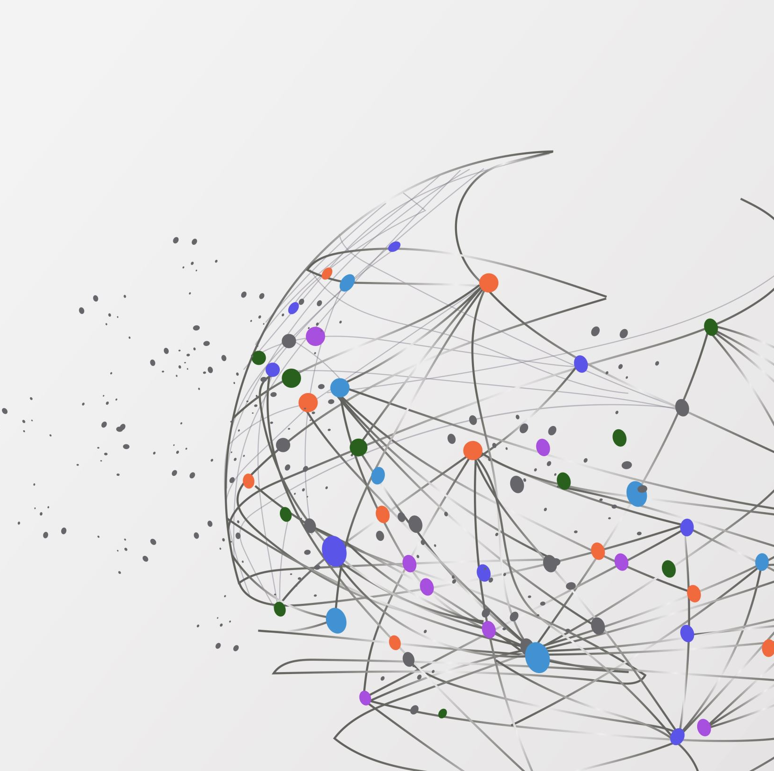
Outline
Executive Summary
Introduction
Methodology
Results
Conclusion
Appendix

Slide 3

Executive Summary
The subsequent approaches were employed for examining the data:
• Data was gathered via web scraping and the SpaceX API;
• Exploratory Data Analysis (EDA) was carried out, which included data wrangling, data visualization, and interactive visual analytics;
• Machine Learning Prediction was utilized.
Summary of all results
• Valuable data was obtained from public sources.
• EDA helped in identifying the most effective features to predict the success of launchings.
• Machine Learning Prediction aided in determining the best model for predicting which characteristics are crucial in maximizing this opportunity using all the collected data.

Slide 4
Project background and context
The goal is to assess the feasibility of the new company, Space Y, to compete against Space X.
Desirable answers
• Favorable outcomes include:
• Predicting successful landings of the first stage of rockets to determine the optimal way to estimate the total cost of launches.
• Determining the ideal location for conducting launches.
Introduction

Slide 5

Section 1

Slide 6
Executive Summary
Data collection methodology:
Information from Space X was acquired through two channels:
• Space X API ( https://api.spacexdata.com/v4/rockets/
• Web scraping (https://en.wikipedia.org/wiki/List_of_Falcon/_9/_and_Falcon_Heavy_).
Perform data wrangling
The collected data was enhanced by generating a landing outcome label, which was based on the outcome data following the analysis and summarization of the characteristics.
Perform exploratory data analysis (EDA) using visualization and SQL
Perform interactive visual analytics using Folium and Plotly Dash
Methodology

Slide 7
Executive Summary
Perform predictive analysis using classification models
The data collected up to this stage was normalized, divided into training and test datasets, and assessed using four distinct classification models. The accuracy of each model was evaluated by utilizing different combinations of parameters.
Methodology

Slide 8
Datasets were gathered from two sources, namely the Space X API (https://api.spacexdata.com/v4/rockets/rockets/) and Wikipedia (https://en.wikipedia.org/wiki/List_of_Falcon/_9/_and_Falcon_Heavy_launches), utilizing web scraping techniques.
Data Collection

Slide 9
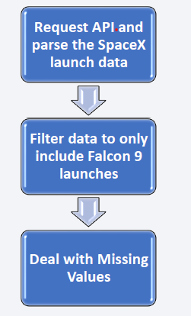
Data Collection – SpaceX API
SpaceX provides a publicly accessible API from which data can be extracted and utilized.
The flowchart adjacent to it was followed to use the API and persist the data.
Data-Science-Capstone/jupyter-labs-spacex-data-collection-api (1).ipynb at main · snigdha-github/Data-Science-Capstone

Slide 10
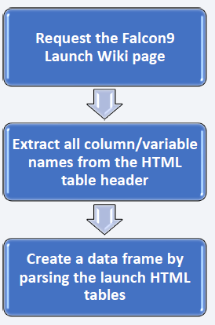
Data Collection - Scraping
Information regarding SpaceX launches can be obtained from Wikipedia as well.
• The data is downloaded from Wikipedia, following the flowchart, and subsequently stored.
Data-Science-Capstone/jupyter-labs-webscraping.ipynb at main · snigdha-github/Data-Science-Capstone

Slide 11

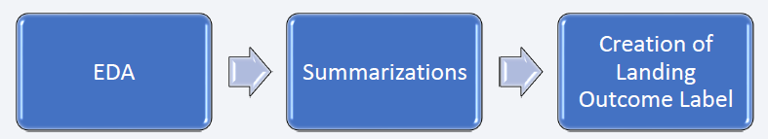
Data Wrangling
At first, the dataset was subjected to some Exploratory Data Analysis (EDA).
• Next, the number of launches per site, frequency of each orbit, and the frequency of mission outcomes per orbit type were computed.
• Lastly, the landing outcome label was generated based on the Outcome column.
Data-Science-Capstone/labs-jupyter-spacex-Data wrangling.ipynb at main · snigdha-github/Data-Science-Capstone

Slide 12
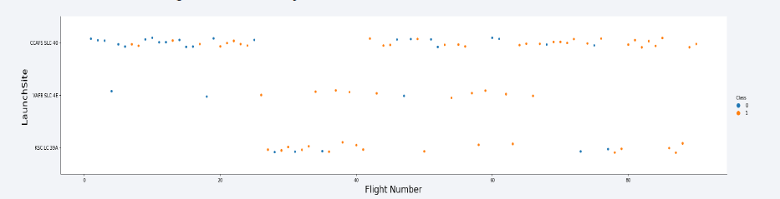
EDA with Data Visualization
To examine the data, scatterplots and bar plots were utilized to depict the correlation between pairs of features such as: • Payload Mass X Flight Number • Launch Site X Flight Number • Launch Site X Payload Mass • Orbit and Flight Number • Payload and Orbit
Data-Science-Capstone/jupyter-labs-eda-dataviz.ipynb at main · snigdha-github/Data-Science-Capstone

Slide 13

EDA with SQL
The following SQL queries were executed:
Query for obtaining the names of the unique launch sites in the space mission
Query for determining the top 5 launch sites whose name begins with the string 'CCA’
• Query for calculating the total payload mass carried by boosters launched by NASA (CRS)
• Query for computing the average payload mass carried by booster version F9 v1.1
• Query for identifying the date when the first successful landing outcome in ground pad was achieved
• Query for acquiring the names of the boosters which have been successful in drone ship and have payload mass between 4000 and 6000 kg
• Query for determining the total number of successful and failure mission outcomes
• Query for obtaining the names of the booster versions which have carried the maximum payload mass
• Query for retrieving the failed landing outcomes in drone ship, their booster versions, and launch site names for the year 2015
• Query for ranking the count of landing outcomes, such as Failure (drone ship) or Success (ground pad)

Slide 14

Build an Interactive Map with Folium
Folium Maps were utilized with the following visual elements:
Markers, representing points such as launch sites
Circles, highlighting areas around specific coordinates, for example, the NASA Johnson Space Center
Marker clusters, grouping events in each coordinate, such as launches in a launch site
Lines, indicating the distances between two coordinates.
Data-Science-Capstone/lab_jupyter_launch_site_location (1).ipynb at main · snigdha-github/Data-Science-Capstone

Slide 15

Build a Dashboard with Plotly Dash
The following graphs and plots were employed to visually represent the data:
Percentage of launches by site
Payload range
By utilizing this combination, it was possible to swiftly examine the relationship between launch sites and payloads, facilitating the identification of the optimal launch site based on payload.
Data-Science-Capstone/labs-jupyter-spacex-Data wrangling.ipynb at main · snigdha-github/Data-Science-Capstone

Slide 16
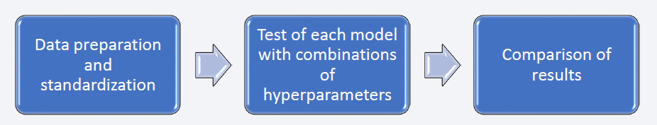
Predictive Analysis (Classification)
Four classification models were compared: logistic regression, support vector machine, decision tree and k nearest neighbors.
Data-Science-Capstone/SpaceX_Machine Learning Prediction_Part_5.ipynb at main · snigdha-github/Data-Science-Capstone

Slide 17

Results
The exploratory data analysis revealed the following insights:
• Space X has used four different launch sites so far.
• The company's initial launches were conducted for its own purposes and for NASA.
• On average, the payload of F9 v1.1 booster was 2,928 kg.
• The first successful landing outcome occurred in 2015, five years after the first launch.
• Many versions of the Falcon 9 booster successfully landed on drone ships, and most of them had payloads above the average.
• Nearly all of the mission outcomes (about 100%) were successful.
• Two versions of the booster (F9 v1.1 B1012 and F9 v1.1 B1015) failed to land on drone ships in 2015.
• The landing outcomes improved over the years.

Slide 18
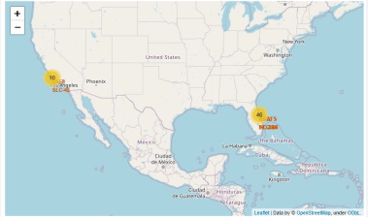
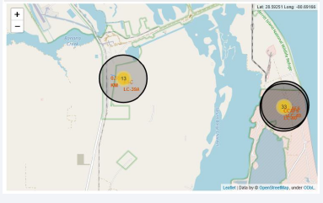
Results
By utilizing interactive analytics, it was discovered that launch sites tend to be located in secure locations, often near bodies of water, and have a well-established logistical infrastructure in the surrounding area.
Additionally, the majority of launches take place at launch sites located on the east coast.

Slide 19
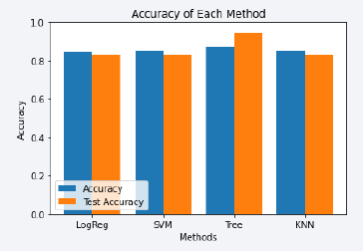
Results
According to the results of the Predictive Analysis, the Decision Tree Classifier model was found to be the most effective in predicting successful landings. It achieved an accuracy of over 87%, with a test data accuracy of over 94%.

Slide 20

Section 2

Slide 21
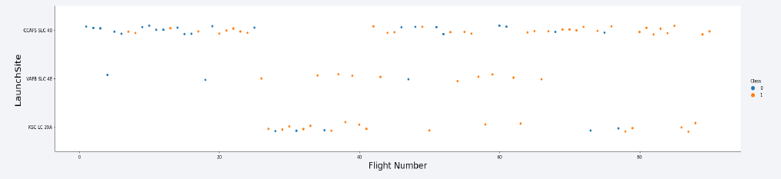
Flight Number vs. Launch Site
Based on the plot below, it can be observed that the most successful launch site currently is CCAF5 SLC 40, as most recent launches from this site were successful. VAFB SLC 4E is in second place, followed by KSC LC 39A in third place. Furthermore, there is an overall improvement in the success rate over time.

Slide 22
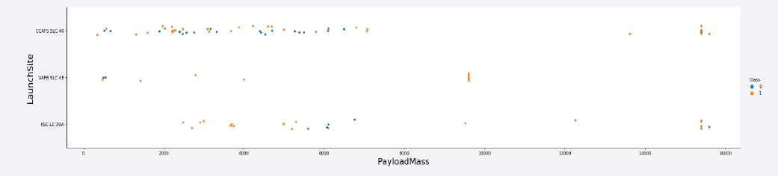
Payload vs. Launch Site
Payloads over 9,000kg (about the weight of a school bus) have excellent success rate;
Payloads over 12,000kg seems to be possible only on CCAFS SLC 40 and KSC LC 39A launch sites.

Slide 23
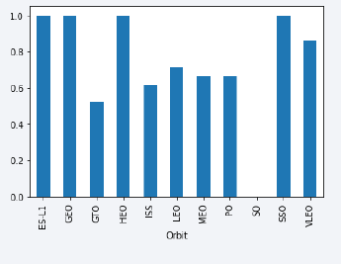
Success Rate vs. Orbit Type
The highest success rates are observed for the following orbits:
ES L1
GEO
HEO
SSO Followed by:
VLEO (above 80%)
LFO (above 70%)

Slide 24
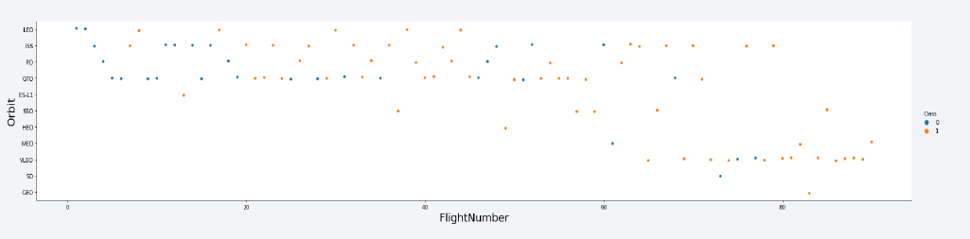
Flight Number vs. Orbit Type
It seems that the success rate has improved over time for all orbits. Moreover, the increasing frequency of VLEO orbit launches indicates that it may be a new business opportunity.

Slide 25
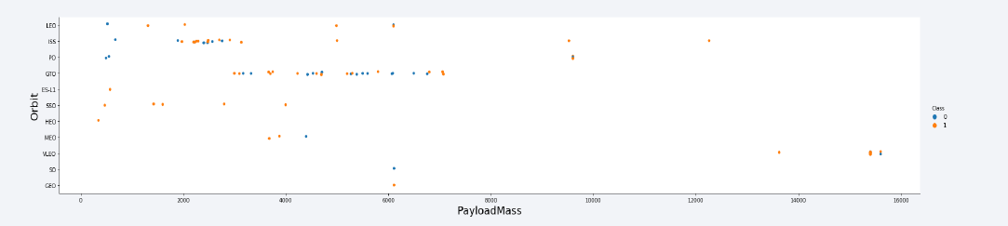
Payload vs. Orbit Type
There seems to be no clear relationship between payload and success rate for the GTO orbit.
The ISS orbit has a wide range of payloads and a high success rate.
There have been relatively few launches to the SO and GEO orbits.

Slide 26
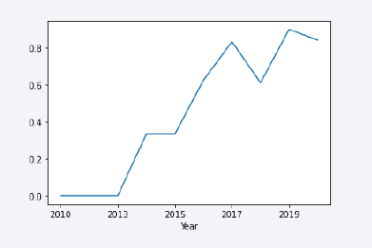
Launch Success Yearly Trend
The success rate showed an increasing trend from 2013 to 2020, with the initial three years being a period of adjustments and technological improvements.

Slide 27
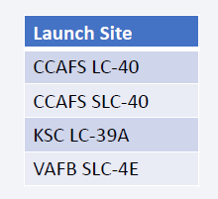
All Launch Site Names
There are four launch sites.
The unique occurrences of "launch_site" values were selected from the dataset to obtain them.

Slide 28
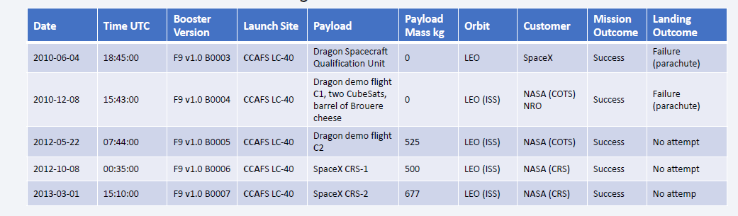
Launch Site Names Begin with 'CCA'
These are the 5 records where launch sites begin with `CCA`

Slide 29
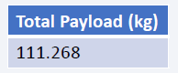
Total Payload Mass
The total mass of payloads carried by boosters launched by NASA:
The above calculation of total payload was performed by summing the payloads with codes containing 'CRS', which are associated with NASA.

Slide 30
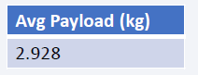
Average Payload Mass by F9 v1.1
The average mass of payloads carried by the F9 v1.1 booster version
By filtering the data based on the booster version mentioned earlier and computing the mean of the payload mass, we arrived at a figure of 2,928 kg.

Slide 31
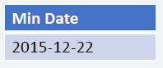
First Successful Ground Landing Date
The first instance of a successful landing on a ground pad.
Filtering the data by successful landings on the ground pad and retrieving the earliest date yields the identification of the first successful landing on 12/22/2015.

Slide 32
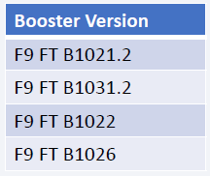
Successful Drone Ship Landing with Payload between 4000 and 6000
Boosters that landed successfully on drone ships with a payload mass between 4000 and 6000.
These four booster versions are obtained by selecting distinct values based on the above filters.

Slide 33
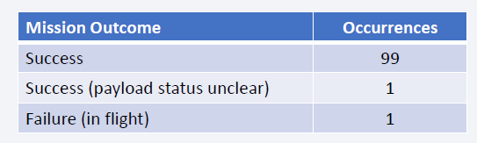
Total Number of Successful and Failure Mission Outcomes
Total Number of Successful and Failed Mission Outcomes:
By grouping mission outcomes and tallying the number of records for each group, the summary above was obtained.

Slide 34
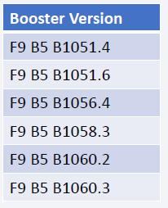
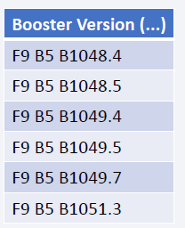
Boosters Which Carried Maximum Payload
Boosters which have carried the maximum payload mass:
The above boosters have carried the maximum payload mass recorded in the dataset.

Slide 35
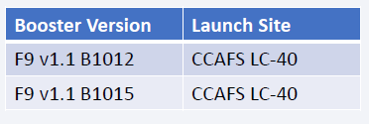
2015 Launch Records
Booster versions and launch site names for failed landing outcomes on drone ships in 2015.
The above list contains only two instances.

Slide 36
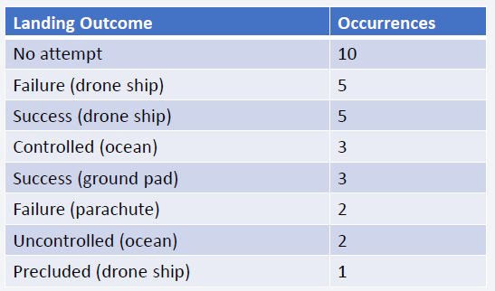
Rank Landing Outcomes Between 2010-06-04 and 2017-03-20
The ranking presented below shows all landing outcomes that occurred between June 4, 2010, and March 20, 2017
This data view highlights the importance of considering the "No attempt" category.

Slide 37

Section 3

Slide 38
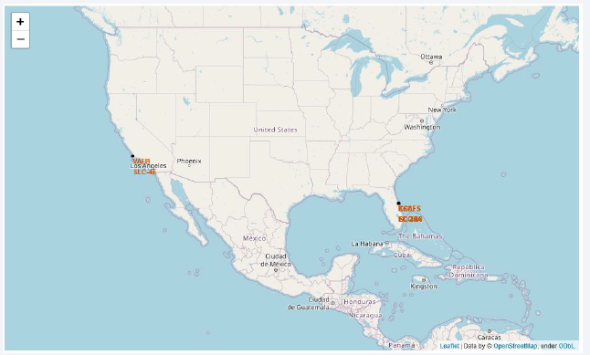
Launch Sites
The launch sites are situated close to the sea, likely for safety reasons, but also within a reasonable distance of roads and railroads

Slide 39
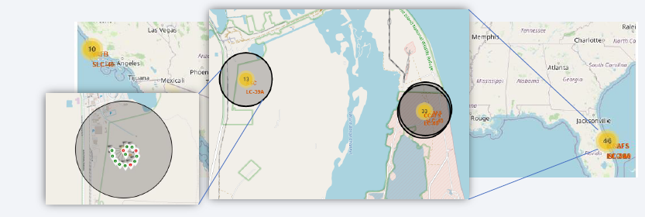
Site-wise Launch Outcomes
Sample of launch outcomes at the KSC LC 39A launch site. Successful outcomes are represented by green markers, while failures are represented by red ones.

Slide 40
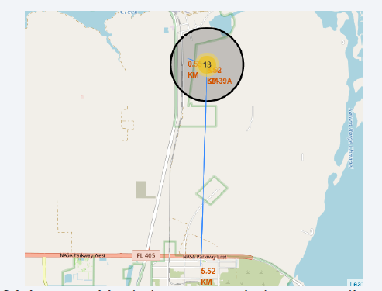
Safety and Logistics
KSC LC 39A launch site exhibits favorable logistic aspects, being in proximity to both a railroad and a road, and comparatively distant from populated regions.

Slide 41

Section 4

Slide 42
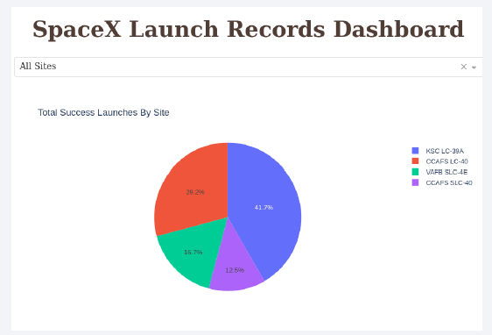
Summary of Successful Launches by Site
The location where the launches are conducted appears to be a crucial element for the success of missions.

Slide 43
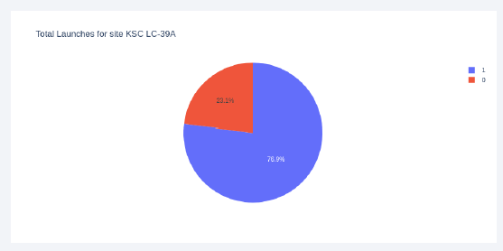
KSC LC-39A Launch Success Ratio
76.9% of launches are successful in KSC LC-39A launch site.

Slide 44
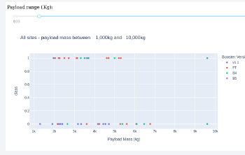
Relationship between Payload and Launch Outcome
The combination of payloads weighing less than 6,000kg and FT boosters seems to have the highest success rate.

Slide 45

Section 5

Slide 46
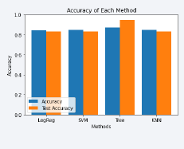
Classification Accuracy
Four models were tested for classification, and their respective accuracies are displayed in the adjacent plot.
The Decision Tree Classifier is the model with the highest classification accuracy, with accuracies that exceed 87%.

Slide 47
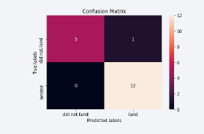
Confusion Matrix
The accuracy of the Decision Tree Classifier is supported by its confusion matrix, which displays a significant number of true positives and true negatives in comparison to the false values.

Slide 48
Conclusions
During the analysis of various data sources, the following findings were refined:
Decision Tree Classifier can be utilized for predicting successful landings and boosting profits.
Although most missions have successful outcomes, successful landing outcomes have shown improvement over time due to advancements in processes and rockets.
KSC LC 39A is the most favorable launch site.

Slide 49


